Slide 1

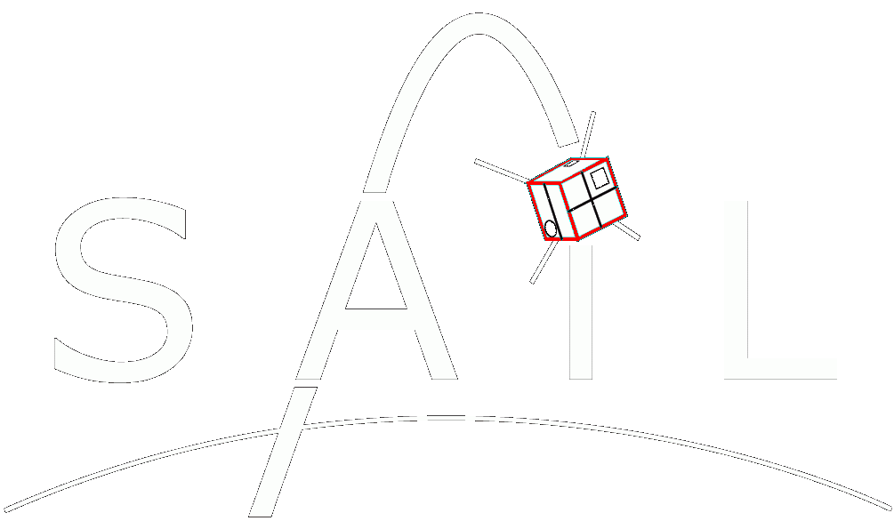
COMPASS
Computational Photometry Analyzer for Small Satellites

Slide 2
Overview
The Computational Photometric-Characterizer/Analyzer for Artificial Satellites (COMPASS) is a desktop-based rendering engine written in C++/OpenGL to produce highly accurate graphical representations of RSOs (resident space objects) and their environments as observed by ground-based telescopes. These renderings are generated and processed within the program in order to infer additional information about the system (photometry curve, attitude, rotation, etc.) and provide the user with a convenient and intuitive interface which can be used to visualize the RSO and directly correlate these visualizations to photometry data within the simulations.

Slide 3
High-Level Requirements
Primary Requirements:
The program shall have the ability to accurately produce high-fidelity renderings of RSOs in low-earth orbit and use these renderings to produce photometry curves from the perspective of an earth-based observer.
The program shall have the ability to reconstruct the attitude and angular motion of an RSO given its shape, orbital parameters, and photometry curve.
The program shall provide a graphical user interface through which the user may specify simulation parameters, run simulations, and observe/interact with renderings and photometry data.
Secondary Requirement:
The program shall have the ability to reconstruct the shape and attitude of an RSO given its orbital parameters and photometry curve.

Slide 4
Additional Implementations
OSCOM simulator and testing platform. Virtually implementing new utilities/techniques within OSCOM such as OpenCV applications (automatic tracking software) or new equipment (simulate filters, telescope optics, cameras, etc.).
Research aid. Provides a more intuitive understanding of how spacecraft configurations (orbit, attitude, rotation, etc.) corellate to light curve data and provide a means of interacting with the scenario to quickly and easily test/explore new ideas.
CubeSat development. Test CubeSat models and configurations within the software in order to optimize their design for use with OSCOM.

Slide 5
Solution Discussion
Rendering the RSO:
Rendering methods: Ray Tracing VS Rasterization
Monte Carlo Ray Tracing algorithms: Trace light rays throughout a scene and simulate their interactions with the surfaces that they encounter. Visually: Extremely Realistic. Computationally: Extremely Expensive. Not Practical for the purposes of this program.
Rasterization and Scanline Rendering: Converting vertex data from virtual models to pixel data. Renders the scene “line by line” producing rows of pixels at a time. Visually: Realistic when implemented with accurate shading algorithms. Computationally: Extremely cheap compared to Ray tracing.
Although rasterization is not quite as accurate as ray tracing algorithms, the visual differences between these methods should have little effect on the apparent brightness of the RSO. (Still needs to be 100% confirmed. What is the resolution of the observational photometry data?)
Phong Shading Algorithm: Interpolation algorithm based on the Phong reflection model to produce accurate renderings of virtual objects. Ignore ambient lighting component b/c no atmosphere.
Use sphere mapping to accurately model reflections on metallic surfaces
Implement shadow mapping algorithms to generate accurate shadows.
Use accurate BRDF data to simulate material properties

Slide 6
Solution Discussion
Modelling the RSO:
Import CAD models to COMPASS directly using common vertex-based model formats. (STL, OBJ, and AMF)
Use Blender to import CAD models and apply colors/textures/material properties/Surface normal/etc. Export blender models into COMPASS
Use CAD models from SAIL CubeSats or Spacecraft Development Club’s RADSat.
NASA has various satellite models publicly available. Use for testing.

Slide 7
Solution Discussion
Rendering the Environment:
RSO Position modelling: Use SGP4 orbit propagator library to accurately model the position/location of the RSO
Render the RSO from the perspective of the telescope, but much closer (almost like you could zoom in a ton with the telescope to produce a resolved image). This way, the change in brightness as seen by the telescope can be calculated more precisely.
Model the Sun, Moon, and Earth in their proper locations relative to the RSO (Probably using info from SGP4 or something similar). Create light sources at the location of each of these bodies that shine on the RSO(figure out proper intensities for these. Earth should definitely be considered. Moon is not as significant. Start with sun and go from there).
Render starfield
Rendering the environment should only be used for sphere mapping and User-End visualization. When rendering the pass used to calculate brightness, we don’t want to include the background in this calculation, just the RSO.

Slide 8
Solution Discussion
Generating Photometry Curves:
Use the “up-close” RSO rendering to accurately determine the RSO’s brightness throughout the pass (I have ideas on how to do this accurately, but I’m still not 100% sure… I’ll have to think about it more and do some research).
Produce a rendering pass from the perspective of the telescope as it would appear in actual observations. (i.e. not zoomed in anymore). The satellite now appears as a couple of pixels, but its brightness fluctuates according to the calculations made during the “up-close” rendering pass in addition to the brightness fluctuations associated with the observing system. Allows for greater precision than just rendering it from really far away in the first place.
Simulate environmental effects on the brightness of the object (atmospheric distortion, etc.)
Simulate the detector itself (data binning, camera noise, etc.)

Slide 9
Solution Discussion
Reconstructing RSO Attitude/Rotation:
Still need to look into it more, but I have some ideas.
According to Euler’s rotation theorem, any displacement of any body in which a point remains fixed in space can be reduced to a single rotation about a single axis. If the program is able to discern a periodicity within the photometry data, it can set the RSO’s rotational period to this value. It can then try a number of configurations/rotations and line up the peaks of the generated light curve with those of the observed light curve. It will run numerous simulations and attempt to narrow in on the configuration that produces the closest fit to the actual data.

Slide 10
Solution Discussion
User Interface:
Load a model of an RSO and its TLE into the program
Specify simulation parameters and render immediately (No photometry data generated) according to rotation/orientation parameters from the user
User can load an RSO, TLE, rotation/orientation, and time parameters and run a simulation to generate a photometry curve. This photometry curve can be viewed side-by-side with a rendering of the RSO to provide a means of visually correlating the data to the orientation of the RSO.
User can load an RSO model, TLE, and time-stamped photometry curve and the program will attempt to reconstruct the RSO’s orientation/rotation. It will produce a visual rendering of the RSO based on the input data.

Slide 11
Solution Discussion
Shape Determination:
Have not looked into this yet. I have no clue at this point :p

Slide 12
Current State
Written in Java (because I used it for my CS225 project). Will start porting to C++ soon for added performance, using QT windowing/GUI system, OpenGL originally built for C++, and because there’s more support for OpenGL C++ than there is for Java.
Current Capabilities:
loads any STL, AMF, or OBJ model file.
User-set initial orientation/rotation of RSO, pass duration, and sample rate.
Renders RSO according to input parameters.
Measures brightness of RSO (based on pixel color values). Relative change in brightness is accurate, but these don’t correlate to actual units yet…
Displays live graph as RSO is rendered. Saves brightness data and allows it to be graphed again later within the program.
Camera orientation is fixed. In the future, this will be set according to the relative locations of the satellite and observer.
Orbital motion of satellite is not modelled yet. Buttons are there just for show at this point, but I was working implementing this towards the end of the previous semester.

Slide 13
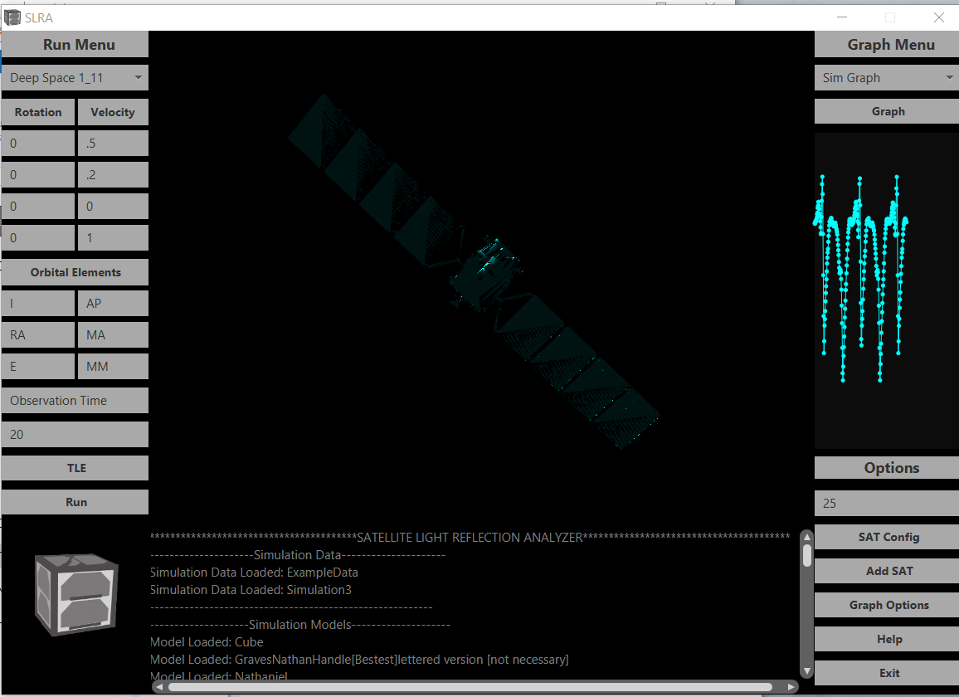
Select data to graph. (new data saved after every simulation)
Select RSO Model
Graph selected simulation in a separate window.
Set Rotation axes for initial orientation and angular velocity
Live graph of RSO brightness. (No units, just shows relative change in brightness for now).
Set initial rotation amount (degrees) or angular velocity (hertz)
Random satellite model from NASA’s website. Default texture is Cyan colored (No particular reason).
Manual orbital elements input… Probably wont use this in the future. Just use TLE
J2000 time of observation. Not implemented yet
Duration of pass. (How long the RSO is rendered)
Does absolutely nothing. Future: set RSO TLE
Sample rate for brightness data. (Hertz)
Run a simulation based on the current parameters
Open a file browser to add a new satellite model.
Output console. Helps with debugging n’ such
Super cool satellite logo that may-or-may-not have been stolen from Spacecraft Development Club…

